Slide 1
A tale of randomization
Chris Brien
Phenomics & Bioinformatics Research Centre, University of South Australia.
The Australian Centre for Plant Functional Genomics, University of Adelaide.
This work was supported by the Australian Research Council.

Slide 2
Outline
Once upon a time.
Randomization analysis.
Examples.
Conclusions.

Slide 3
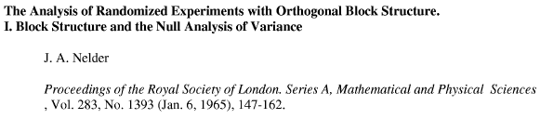
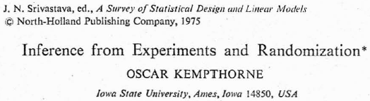
1. Once upon a time
In the 70s I was a true believer:
  We are talking randomization inference.

Slide 4

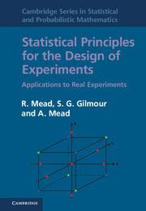
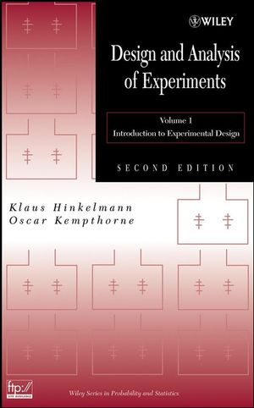
Purism
Kempthorne (1975):
These books demonstrate that
p-value from randomization analysis
is approximated by p-value from
analyses assuming normality for
CRDs & RCBDs;
Welch (1937) & Atiqullah (1963)
show that true, provided the observed data actually conforms to the variance for the assumed normal model (e.g. homogeneity between blocks).

Slide 5
Sex created difficulties … and time
Preece (1982, section 6.2): Is Sex a block or a treatment factor?
  Block factors cannot be tested.
  Semantic problem: what is a block factor?
  Often Sex is unrandomized, but is of interest – I believe this to be the root of the dilemma.
  If it is unrandomized, it cannot be tested.
In longitudinal studies, Time is similar. Sites also.
What about incomplete block designs with recombination of information? Missing values?
Seems that not all inference possible with randomization analysis.

Slide 6
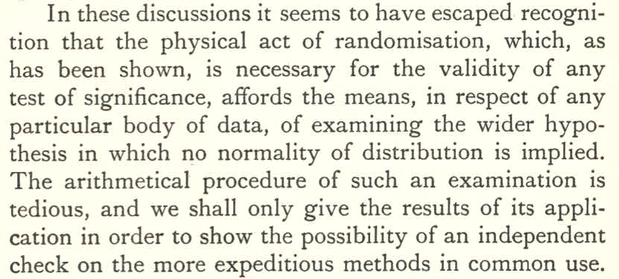
Fisher (1935, Section 21) first proposed randomization tests:
It seems clear that Fisher intended randomization tests to be only a check on normal theory tests.
Added Section 21.1 to the 1960, 7th edn to emphasize.

Slide 7
Conversion
I became a modeller,
  BUT, I did not completely reject randomization inference.
I have advocated randomization-based mixed models:
  a mixed model that starts with the terms that would be in a randomization model (Brien & Bailey, 2006; Brien & Demétrio, 2009).
This allowed me to:
  test for block effects and block-treatment interactions;
  model longitudinal data.
I comforted myself that when testing a model that has an equivalent randomization test, the former is an approximation to the latter and so robust.

Slide 8
More recently ….
Cox, Hinkelmann and Gilmour pointed out, in the discussion of Brien and Bailey (2006),
  no one had so far indicated how a model for a multitiered experiment might be justified by the randomizations employed.
I decided to investigate randomization inference for such experiments,
  but first single randomizations.

Slide 9
2. Randomization analysis: what is it?
A randomization model is formulated.
  It specifies the distribution of the response over all randomized layouts possible for the design.
Estimation and hypothesis testing based on this distribution.
  Will focus on hypothesis testing.
A test statistic is identified.
The value of the test statistic is computed from the data for:
  all possible randomized layouts, or a random sample (with replacement) of them
  ⇒ randomization distribution of the test statistic, or an estimate;
  the randomized layout used in the experiment: the observed test statistic.
The p-value is the proportion of all possible values that are as, or more, extreme than the observed test statistic.
Different to a permutation test in that it is based on the randomization employed in the experiment.

Slide 10
Randomization model for a single randomization
Additive model of constants:
y = w + X_{h}τ
  where y is the vector of observed responses;
  w is the vector of constants representing the contributions of each unit to the response; and
  τ is a vector of treatment constants;
  X_{h} is design matrix showing the assignment of treatments to units.
Under randomization, i.e. over all allowable unit permutations applied to w, each element of w becomes a random variable, as does each element of y.
  Let W and Y be the vectors of random variables and so we have
Y = W + X_{h}τ.
  The set of Y_{ω} forms the multivariate randomization distribution, our randomization model.

Slide 11
Randomization model (cont’d)
  Now, we assume E_{R}[W] = 0 and so E_{R}[Y] = X_{h}τ .
Further,
  H is the set of generalized factors (terms) derived from the factors on the units;
  ψ_{H} is the canonical component of excess covariance for H ∈ H;
  S_{H}, are known matrices.
This model has the same terms as a randomization-based mixed model (Brien & Bailey, 2006; Brien & Demétrio, 2009)
However, the distributions differ.
Notes:
Spectral component = eigenvalue
B are known incidence matrices, S are know summation/relation matrices and Q are known projection matrices.

Slide 12
Randomization estimation & testing
Propose to use I-MINQUE to estimate the ψs and use these estimates to estimate τ via EGLS.
I-MINQUE yields the same estimates as REML, but without the need to assume normal response.
Test statistics:
  F_{Wald} = Wald test statistic / numerator d.f.
    For an orthogonal design, F_{Wald} is the same as the F from an ANOVA. Otherwise, it is a combined F test statistic.
  Intrablock F = ratio of MSqs from a single stratum.
Notes:
I-MINQUE - iterative minimum norm quadratic unbiased estimation

Slide 13
Test statistic distributions
Randomization distribution of a test statistic:
  Evaluate the test statistic for all allowable permutations of the units for the design employed;
  This set of values is the required distribution.
Under normality of the response, the null distribution of F_{Wald} is:
  for orthogonal designs, an exact F-distribution;
  for nonorthogonal designs, an F-distribution asymptotically.
Under normality of the response, the null distribution of an intrablock F-statistic is an exact F-distribution.

Slide 14
3. Examples
Wheat experiment in a BIBD (Joshi, 1987)
Rabbit experiment using the same BIBD (Hinkelmann & Kempthorne, 2008).
Casuarina experiment in a latinized row-column design (Williams et al., 2002).

Slide 15
Wheat experiment in a BIBD (Joshi, 1987)
Six varieties of wheat are assigned to plots arranged in 10 blocks of 3 plots.
The intrablock efficiency factor is 0.80.
The ANOVA with the intrablock F and p:
plots tier |  | treatments tier
source | d.f. | source | d.f. | MS | F | p-value
Blocks | 9 | Varieties | 5 | 39.32 | 0.58 | 0.718
 |  | Residual | 4 | 67.59 | 1.17
Plots[B] | 20 | Varieties | 5 | 231.29 | 4.02 | 0.016
 |  | Residual | 15 | 57.53
F_{Wald} = 3.05 with p = 0.035 (ν₁ = 5, ν₂ = 19.1).
Estimates: ψ_{B} = 14.60 (p = 0.403); ψ_{BP} = 58.28.
Notes:
Thanks to Clarice

Slide 16
Test statistic distributions
50,000 randomly selected permutations of blocks and plots within blocks selected.
Intrablock F-statistic
Combined F-statistic
Peak on RHS is all values ≥ 10.

Slide 17
Combined F-statistic
Samples from
Randomization distribution
Parametric bootstrap
Part of the discrepancy between F- and the randomization distributions is that combined F-statistic is only asymptotically distributed as an F.
  Differs from Kenward & Rogers (1997) & Schaalje et al (2002) for nonorthogonal designs.
Notes:
Generated data from N(0, Vhat)

Slide 18
Two other examples
Rabbit experiment using the same BIBD (Hinkelmann & Kempthorne, 2008).
  6 Diets assigned to 10 Litters, each with 3 Rabbits.
  Estimates: ψ_{L} = 21.70. ψ_{LR} = 10.08.
Casuarina experiment in a latinized row-column design (Williams et al., 2002).
  4 Blocks of 60 provenances arranged in 6 rows by 10 columns.
  Provenances grouped according to 18 Countries of origin.
  2 Inoculation dates each applied to 2 of the blocks.
  Estimates: ψ_{C} = 0.2710; ψ_{B}, ψ_{BR} , ψ_{BC} < 0.06;
  ψ_{BRC} = 0.2711.

Slide 19
ANOVA for Casuarina experiment
plots tier |  | treatments tier
source | d.f. | source | d.f. | Eff. | MS | F | p-value
Blocks | 3 | Innoculation | 1 |  | 11.54 | 11.46 | 0.077
 |  | Residual | 2 |  | 1.01 | 1.17
Columns | 9 | Country | 9 |  | 7.25
Rows[B] | 20 | Country | 17 |  | 0.90
 |  | Provenance | 3 |  | 0.43
B#C | 27 | Country | 17 |  | 0.69
 |  | Provenance | 10 |  | 0.48
R#C[B] | 176 | Country | 17 | 0.761 | 2.46 | 10.25 | <0.001
 |  | Provenance | 41 | 0.685 | 0.29 | 1.22 | 0.235
 |  | I#C | 17 | 0.681 | 0.13 | 0.54 | 0.917
 |  | I#P | 41 | 0.522 | 0.15 | 0.63 | 0.938
 |  | Residual | 60 |  | 0.24
Provenance represents provenance differences within countries.
Notes:
Eff. = harmonic mean or average canonical efficiency factor.

Slide 20
Comparison of p-values
Example | Source | Intrablock F |  |  | F_{Wald} (Combined)
 |  | ν₂ | F-distri-bution | Randomiz-ation | ν₂ | F-distri-bution | Randomiz-ation
Wheat | Varieties | 15 | 0.016 | 0.012 | 19.1 | 0.035 | 0.095
Rabbit | Diets | 15 | 0.038 | 0.039 | 16.0 | 0.032 | 0.035
Tree | Country | 60 | <0.001 | <0.001 | 79.3 | <0.001 | 0.013
 | Provenance | 60 | 0.235 | 0.232 | 79.0 | 0.338 | 0.484
 | Innoc#C | 60 | 0.917 | 0.917 | 84.8 | 0.963 | 0.975
 | Innoc#P | 60 | 0.938 | 0.937 | 81.1 | 0.943 | 0.969
For intrablock F, p-values from F and randomization distributions generally agree.
For F_{Wald}, p-values from F-distribution generally underestimates that from randomization distribution:
  (Rabbit Diets an exception – little interblock contribution).

Slide 21
A controversy
Should nonsignificant (??) unit sources of variation be removed and hence pooled with other unit sources?
The point is that effects hypothesized to occur at the planning stage have not eventuated.
  A modeller would remove them;
  Indeed, in mixed-model fitting using REML will have no option if the fitting process does not converge.
Some argue, because in randomization model, must stay.
  Seems reasonable if doing randomization inference.
Sometimes-pooling may disrupt power and coverage properties of the analysis (Janky, 2000).

Slide 22
4. Conclusions
Fisher was right:
  One should employ meaningful models;
  Randomization analyses provide a check on parametric analyses.
I am still a modeller, with the randomization-based mixed model as my starting point.
I am happy that, for single-stratum tests, the normal theory test approximates an equivalent randomization test, when one exists.
However, the p-values for combined test-statistics from the F-distribution are questionable:
  novel that depends on ‘interblock’ components;
  need to do bootstrap or randomization analysis for F_{Wald} when denominator df for intrablock-F and F_{Wald} differ markedly;
  this has the advantage of avoiding the need to pool nonsignificant (??) unit sources of variation, although fitting can be challenging.
Similar results, but with a twist, apply to two randomizations in a chain, but time does not allow me to go into this.

Slide 23
References
Atiqullah, M. (1963) On the randomization distribution and power of the variance ratio test. J. Roy. Statist. Soc., Ser. B (Methodological), 25: 334-347.
Brien, C.J. & Bailey, R.A. (2006) Multiple randomizations (with discussion). J. Roy. Statist. Soc., Ser. B (Statistical Methodology), 68: 571-609.
Brien, C.J. & Demétrio, C.G.B. (2009) Formulating Mixed Models for Experiments, Including Longitudinal Experiments." J. Agric. Biol. Environ. Statist., 14: 253-280.
Edgington, E.S. (1995) Randomization tests. New York, Marcel Dekker.
Fisher, R.A. (1935, 1960) The Design of Experiments. Edinburgh, Oliver and Boyd.
Hinkelmann, K. & Kempthorne, O. (2008) Design and analysis of experiments. Vol I. Hoboken, N.J., Wiley-Interscience.
Janky, D.G. (2000) Sometimes pooling for analysis of variance hypothesis tests: A review and study of a split-plot model. The Amer. Statist. 54: 269-279.
Joshi, D.D. (1987) Linear estimation and design of experiments. Delhi, New Age Publishers.

Slide 24
References (cont’d)
Kempthorne, O. (1975) Inference from experiments and randomization. A Survey of Statistical Design and Linear Models. J. N. Srivastava. Amsterdam., North Holland.
Mead, R., S. G. Gilmour & Mead, A.. (2012). Statistical principles for the design of experiments. Cambridge, Cambridge University Press.
Nelder, J.A. (1965) The analysis of randomized experiments with orthogonal block structure. I. Block structure and the null analysis of variance. Proc. Roy. Soc. Lon., Series A, 283: 147-162.
Nelder, J. A. (1977). A reformulation of linear models (with discussion). J. Roy. Statist. Soc., Ser. A (General), 140: 48-77.
Preece, D.A. (1982) The design and analysis of experiments: what has gone wrong?" Util. Math., 21A: 201-244.
Schaalje, B. G., J. B. McBride, et al. (2002). Adequacy of approximations to distributions of test statistics in complex mixed linear models. J. Agric. Biol, Environ. Stat., 7: 512-524.
Welch, B.L. (1937) On the z-test in randomized blocks and Latin squares. Biometrika, 29: 21-52.
Williams, E.R., Matheson, A.C. & Harwood, C.E. (2002). Experimental design and analysis for tree improvement. Collingwood, Vic., CSIRO Publishing.

